Slide 1

A call to arms: Raising the bar for Project Controls!
Simon Taylor & Carolyn Browning

Slide 2


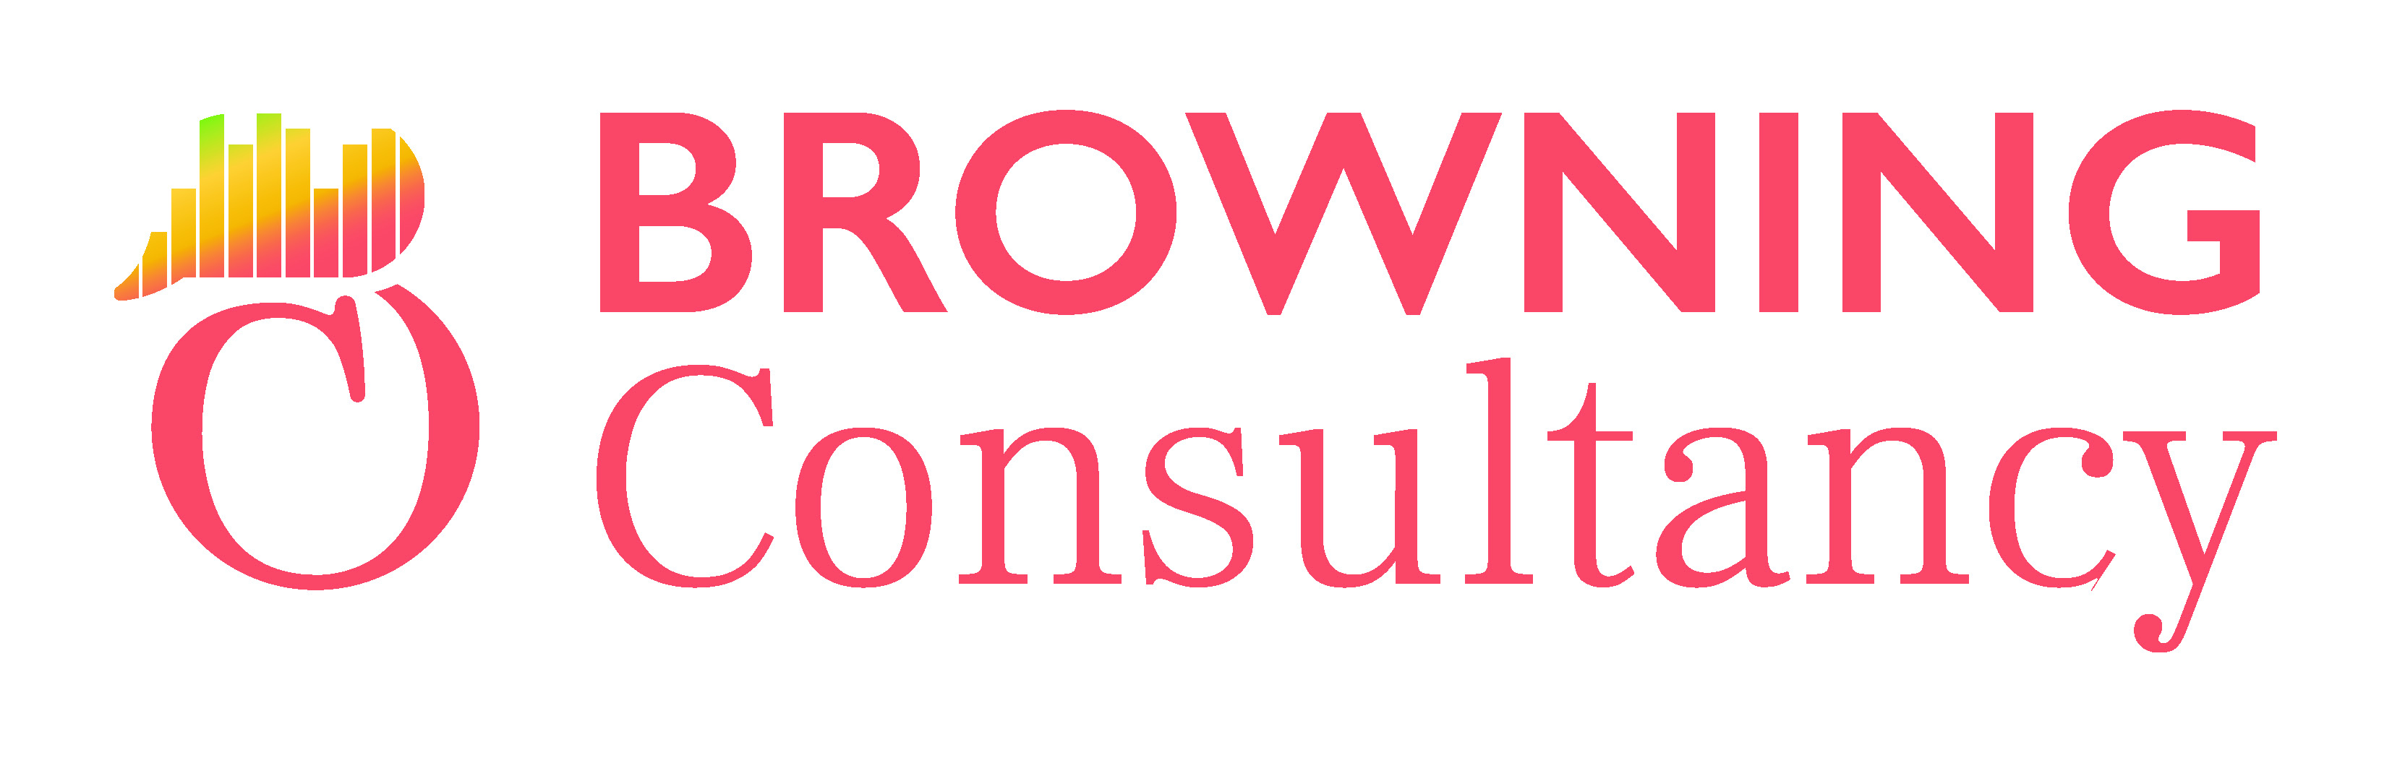


Who are we.
A call to arms: Raising the bar for Project Controls!
Carolyn Browning
Managing Director, Browning Consultancy
Director & Company Secretary – ACostE
Simon Taylor
Co-Founder & Executive Director, th3rdcurve

Slide 3
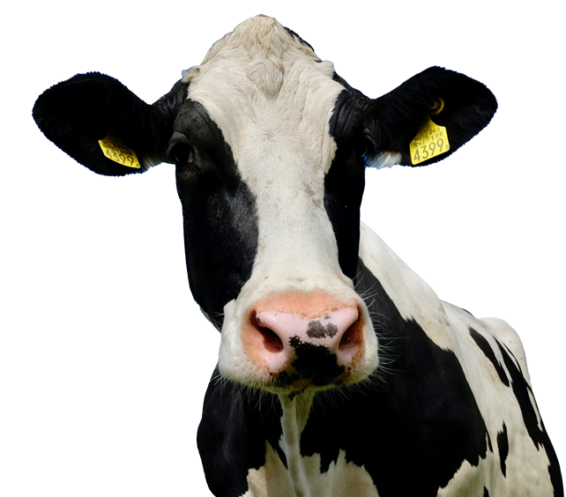
A call to Arms.
A call to arms: Raising the bar for Project Controls!

Slide 4

A call to arms: Raising the bar for Project Controls!
“
Every year, approximately $48 trillion are invested in projects. Yet according to the Standish Group, only 35%
of projects are considered successful.
The wasted resources and unrealized
benefits of the other 65% are mind-blowing .
Harvard Business Review
”
Holy Cow
Notes:
Quote used in presentation overview – setting the scene

Slide 5
EVA 27: Mark Wild.
A call to arms: Raising the bar for Project Controls!

Slide 6
Developing Competence
A call to arms: Raising the bar for Project Controls!
Experience
Knowledge gained through direct observation or participation.
Skill
The ability to do something.
Technical Skills
Soft Skills
Competency
The ability to
perform a
particular task.
Knowledge
Facts, information & skills gained through education or experience.
Behaviour
The way in which one conducts oneself.
Soft Skills
Ethics & Morals
Culture & Ethics
The expectations of the
organisation, leaders & peers.

Slide 7
A call to arms: Raising the bar for Project Controls!
Macro-Trends:
The
Challenge Ahead.

Slide 8
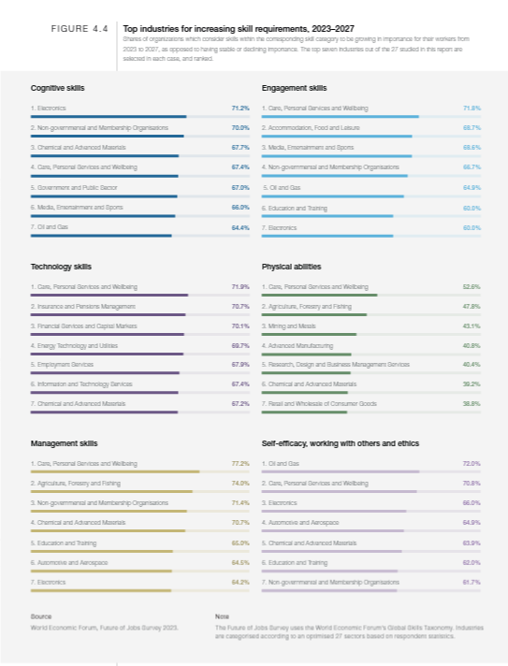
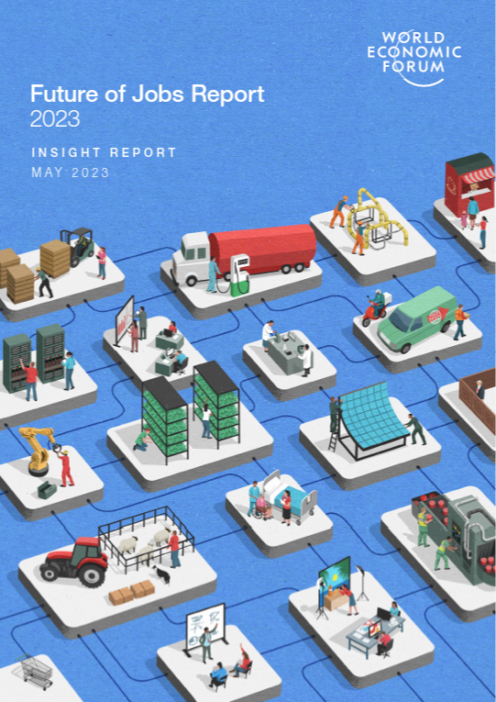
Macro-trends.
A call to arms: Raising the bar for Project Controls!
World Economic Forum
Future of Jobs Survey 2023
Key business transformation trends
Adopting new technologies
Ensuring digital access
Environmental, Social and Governance Standards (ESG)
Green transition
All set amid;
Slower economic growth
Rising cost of living

Slide 9
Barriers to Business Transformation
A call to arms: Raising the bar for Project Controls!
Skill gaps in teams and leadership.
Outdated regulatory, governance and assurance frameworks.
Notes:
However to successfully undertake any transformation businesses are being blocked by a lack of skills in the org and wider in the marketplace, including their leadership!
And also stuck in no longer fit for purpose governance structures and legislative environments

Slide 10
But AI is going to fix all this right!?
Robots will tell us what to do?
A call to arms: Raising the bar for Project Controls!

Slide 11
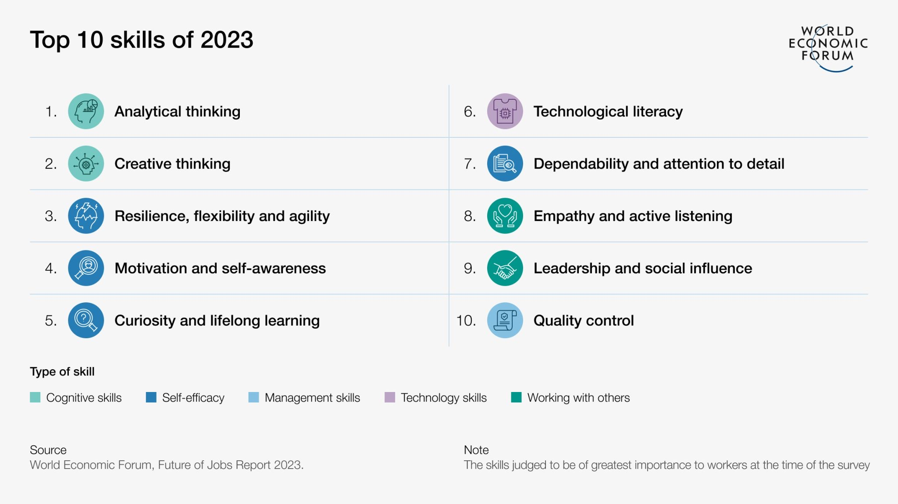
Notes:
Despite AI and technology being central in the news, the top 10 skills are broadly focused on cognitive and core skills. Unfortunately, cognitive and core skills are rarely rewarded, and not focused on in project implementation.

Slide 12
The Challenge.
A call to arms: Raising the bar for Project Controls!
Organisations and projects need to transform;
  Technology
  Environmental, Social and Governance Standards
Blocked By Skill Gaps;
  Cognitive and core skills
  Outdated regulatory and governance frameworks
  Technological Competence
Historically, high incentivisation on;
  Results and metrics
  No bad news
  Process and bureaucracy
Failing to address

Slide 13
A call to arms: Raising the bar for Project Controls!
The Future and Opportunities Ahead.

Slide 14
Opportunities.
A call to arms: Raising the bar for Project Controls!
Behaviours;
Empathy, Creativity, Transparency, Embrace change, Care & Share
Collaboration;
Focusing on the core reasons for the project and adding value continuously
Data;
Becoming more accessible and usable, providing information for insight and decision making

Slide 15
Gap between strategy and execution...
A call to arms: Raising the bar for Project Controls!
How do I
actually
do this?

Slide 16
Developing Competence
A call to arms: Raising the bar for Project Controls!
Experience
Knowledge gained through direct observation or participation
Skill
The ability to do something.
Technical Skills
Soft Skills
Competency
The ability to
perform a
particular task
Knowledge
Facts, information & skills gained through education or experience
Behaviour
The way in which one conducts oneself.
Soft Skills
Ethics & Morals
Culture & Ethics
The expectations of the
organisation, leaders & peers

Slide 17







What do we need to drive decision excellence...?
A call to arms: Raising the bar for Project Controls!
Data insight
& reports
Systems
Data & Data Structure
The Team
Process
Training
Client & Suppliers

Slide 18
What are the key enablers for insight?
A call to arms: Raising the bar for Project Controls!
STRATEGY
Aligned with the reasons behind the project and key drivers
GOOD PRACTICE
Follow good quality, relevant processes that deliver the right outputs
CAPABILITY
Teams should have the right competencies to deliver excellence
POSITIVE STAKEHOLDERS
Stakeholders should the project and feel part of the solution
ACCESSIBLE SYSTEMS
Ability to access systems and data at all times and places
QUALITY DATA
Trustworthy, high-quality data is required to make the best decisions
PEOPLE
People, with the required competencies to deliver on challenges and realise the benefits
CULTURE
A positive culture that promotes cohesion, positivity and professionalism.
Leadership that tolerates hearing the truth

Slide 19
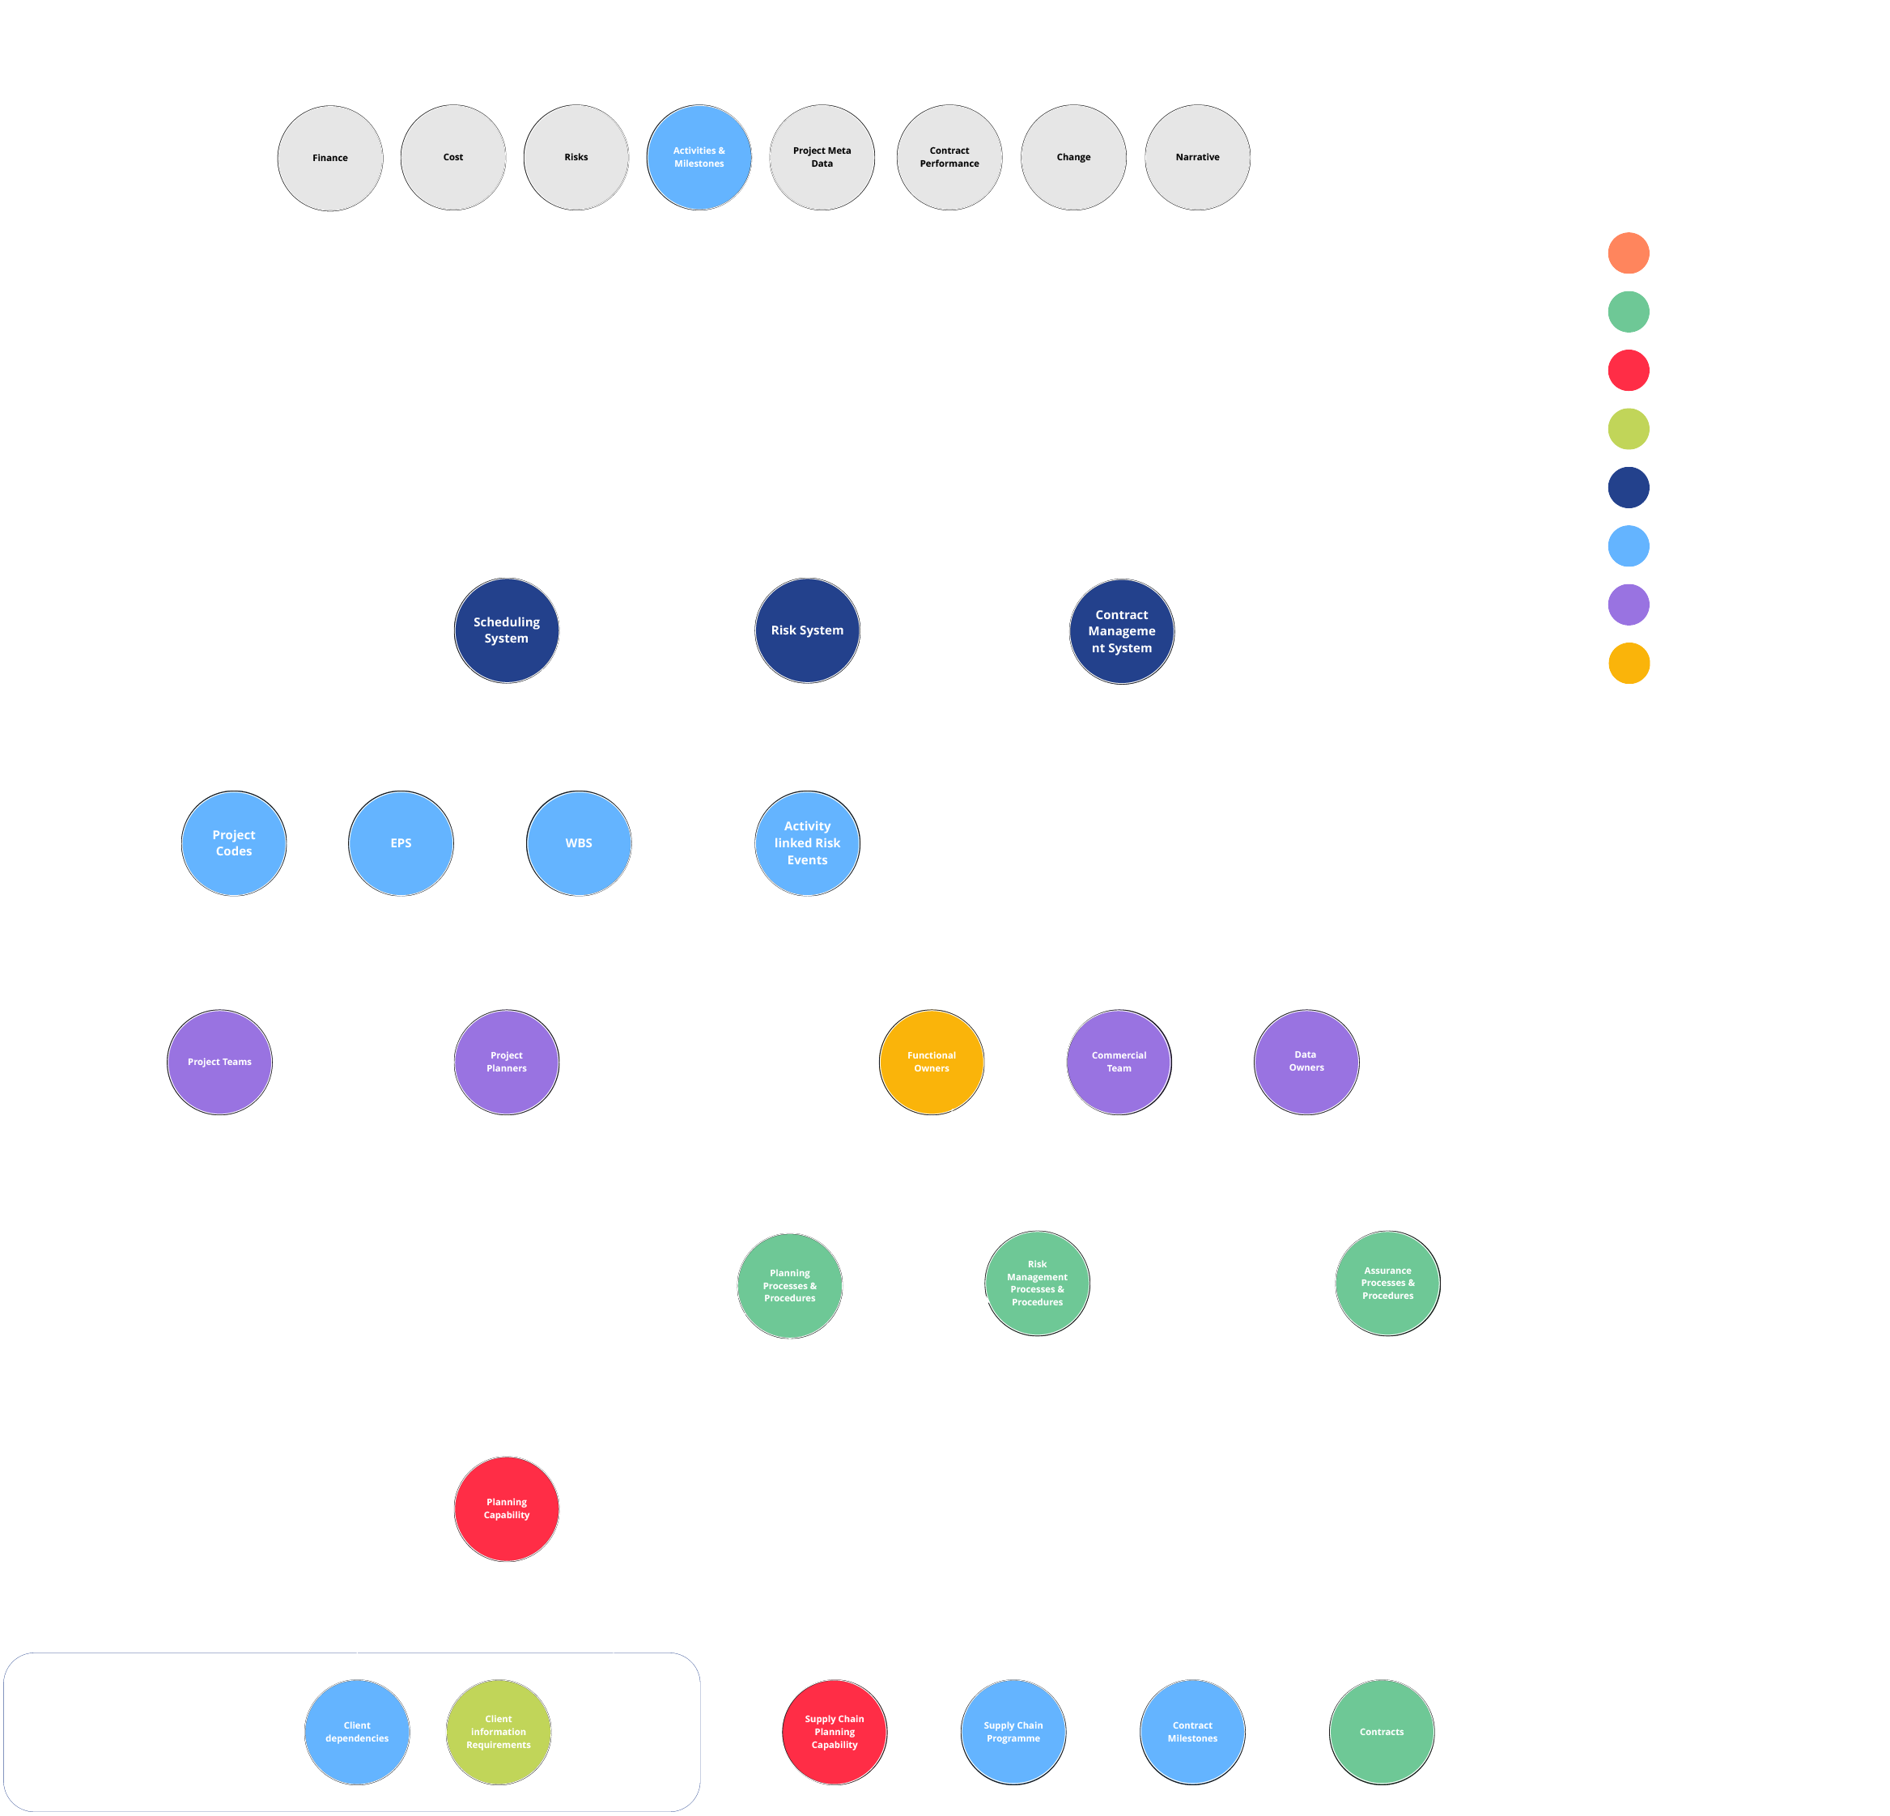
Time.?
A call to arms: Raising the bar for Project Controls!
Insight data points we care about
Critical path activities
Performance baselines
Interfaces (dependencies)
Milestone progress (% complete)
Key milestone performance
Float erosion
Forecast confidence
Forecast accuracy
Activity duration benchmarks
Schedule quality indicator
Time-phased risk events for active risk waterfall
Commercial events
Schedule Performance Index (SPI)
Insight
Systems
Data
The Team
Process
Training
Clients

Slide 20
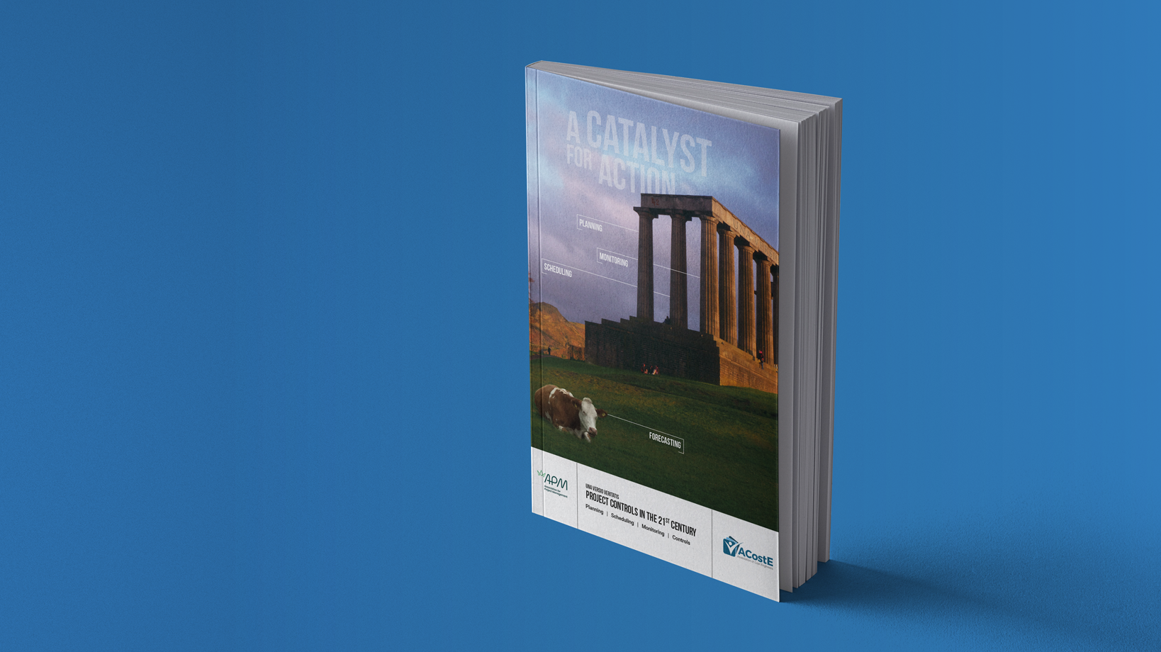
The
Book...
Notes:
Can we make this more visual for the audience? Bring out the elements…

Slide 21
Background
Purpose of Book.?
A call to arms: Raising the bar for Project Controls!
New Book that includes updated content from PSMC book
Working title ‘Project Controls in 21st Century’
Written by practitioners for practitioners
All levels of experience and not just for Project Controls
Simple English ~GCSE reading age
English as a Second Language
High level of visuals / avoid large slabs of text
Anonymised case studies to aid understanding and give context for application
One of the best-selling books within APM currently
Answering "Why do my projects still fail when I use Project Controls?"
Why was Crossrail not delivered in time and on budget when it had all the sophisticated PC tools?
Collaborative partnership between APM and ACostE

Slide 22
Unique Multi Industry Peer Reviewed Publication
A call to arms: Raising the bar for Project Controls!
Experienced practitioners covering multiple industries
  Construction
  Defence
  Rail
  Aerospace
  Infrastructure
  Education
  Training Boards & Assessors
  Oil and Gas
  Nuclear
  Energy & Renewables
  Pharmaceuticals
Multiple perspectives (Client, delivery, consultant, trainer)
Forthcoming ISO standard complaint

Slide 23
A call to arms: Raising the bar for Project Controls!
How will you ensure Success?
Be part of the change

